Slide 1
Inception Phase – Customer Loyalty Program
Amir Abdelaziz, Ben Burwell, Ahmed Gure, Diriye Diriye

Slide 2
Assignments – Delete this slide eventually.
Introduction - Amir
Vision and scope -Amir
Business value - Amir
Feasibility studies –Ben
Software development methodology - Ben
Proposed system functionalities –Ahmed
Initial use case diagram of your system – Ahmed
Hardware/software requirements – diriye

Slide 3
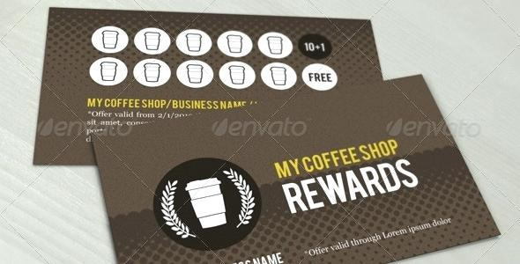
Introduction
What is a loyalty program?
customers return to stores
How does it work?

Slide 4
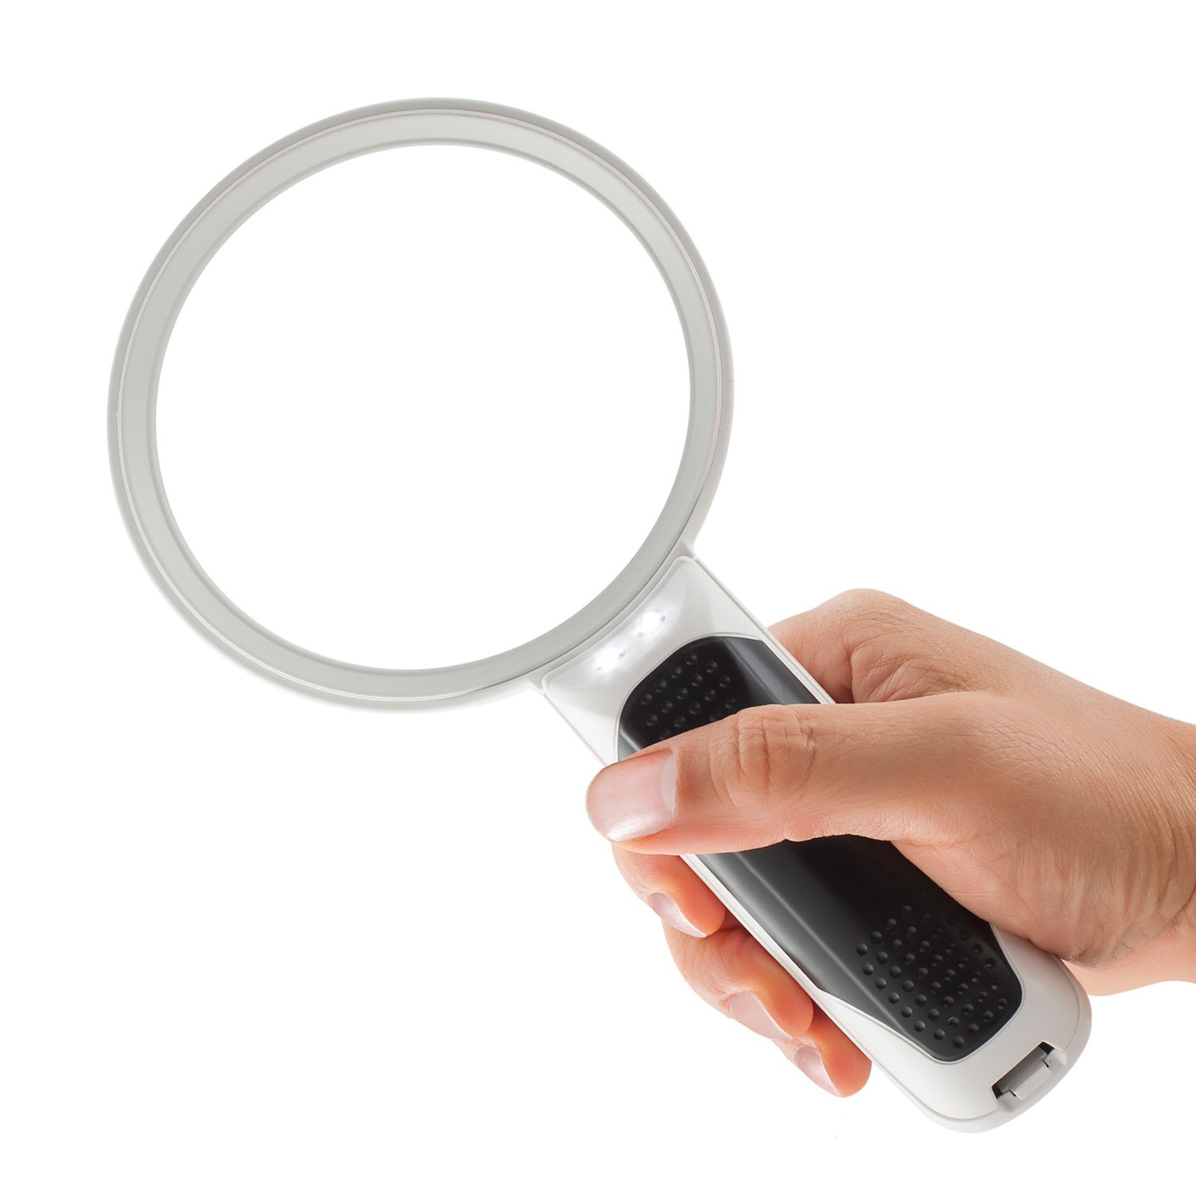
Vision and Scope
Why are we creating this program?
A lot of factors go into determining this
How will this strategy improve the business?
The goal is to create customer loyalty while increasing profits

Slide 5
Business Value
Promote customer loyalty
Increase customer spending
Reduce cost to serve customers
Maximize customer lifetime
Maintain high reputation

Slide 6
Feasibility Studies
►Is it worth creating?
We are going to want to predict before we start if it is worth or realistic to create.
►Is it Feasible?
During the inception phase we will want to ask ourselves this. Do we have the technology, the resources, will it be a good investment?

Slide 7

Feasibility Studies
►Factors that should be looked at.
►Project the cost
►Project the income
►Conduct a survey
►Predict a timeline
►Review all data
►Make a yes or no decision

Slide 8
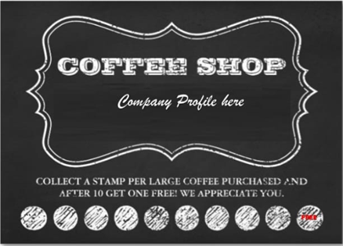
Feasibility Studies
►Example survey/study: Loyalty Program in Paper Punch
►Select a few stores to hand out loyalty punch cards.
►Have the stores keep track of who declines or accepts.
►This will give us an idea if the customers are even interested in the program.

Slide 9
Software Development Methodology
Agile Development
►Iterative
►Work for awhile, then meet up, and plan again
►Quick meetings
►Highly collaborative
►Opposite of the waterfall technique which is more like a solid blueprint.

Slide 10
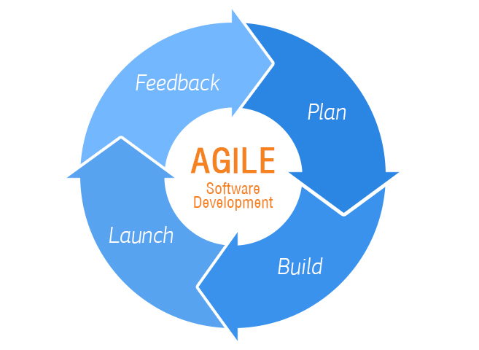
Software Development Methodology

Slide 11
Proposed System Functionality
The purpose of the of the application to provide a way for customers to view a reward counter for customers that purchase coffee from a coffee shop. Customers are also able to purchase coffee through the app.

Slide 12
Initial use case diagram
Customer enter pin. App shows points. Customer is able to purchase coffee.
Admin is able to delete customers and is able to add more or subtract from the menu.
Actors: Customer and Admin

Slide 13
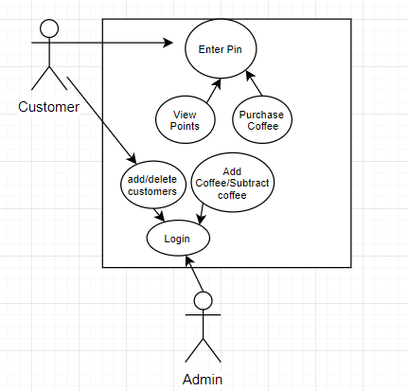
Case Diagram: Enter Pin

Slide 14
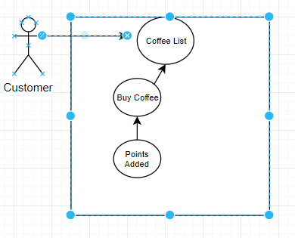
Use Case Diagram: Customer Coffee list

Slide 15
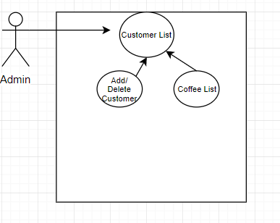
Use Case Diagram: Admin Customer List

Slide 16
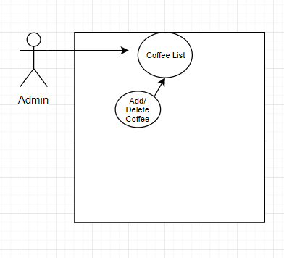
Use Case Diagram: Admin Coffee List

Slide 17
Hardware/Software Requirements
Hardware requirement:
Computer

Slide 18
Hardware/Software Requirements
Software requirement:
Agile methodology
Java Programming

